Slide 1

COMPREHENSIVE ANALYSIS OF THE AVIATION INDUSTRY
A look into the airplane private and commercial industry to gain insights on the best approach to implement an entry into the industry.
September 25, 2024

Slide 2

Contents
Understanding the question
What does the business want to achieve
Analysis process
Key Metrics factored in during the data analysis with relevant charts
Conclusion
Giving recommendations according to insights gained from the data

Slide 3

???Understanding the question at hand???
PURCHASING AND OPERATING AIRPLANES FOR COMMERCIAL AND PRIVATE ENTERPRISES

Slide 4
Key Metrics to factor in when purchasing airplanes
Considering the many makes and models of airplanes in the market, we have to get the safest for the passengers and most resilient incase of accidents.
Aircraft Make & Model
Type of Engine
Different types of engines fair variedly during the occurrence of accident. It also answers the question of durability ,maintenance and probability of occurrence of risk.
Incase of damage of one engine are more engines relevant considering how helpful they have been in accidents.
Number of Engines
Which aircrafts are safer, those amateur built or the alternatives.
Amateur Build

Slide 5

Analysis Process
with data visualization and advanced analytics

Slide 6
Aircraft Risk Assessment
Severity of a hazard
Impact on safety of occupants
How safe is the aircraft when potential hazards are considered
Probability of occurrence
Making direct numerical estimates on probability if data allows
Historical data of failure rates
Manifestation data associated with human error needs subjective assessment
Tolerability of risk
After satisfactory analysis of the two perspectives above, tolerability of risk that each aircraft poses can be determined. We multiply the severity by probability to get a comparable metric for comparison.

Slide 7
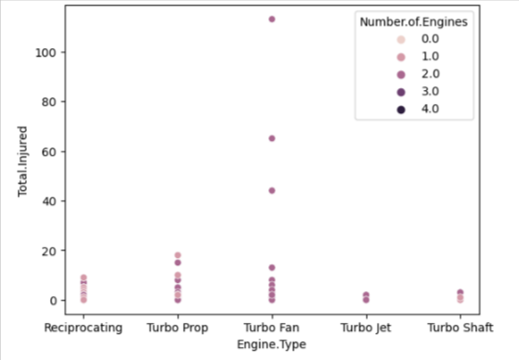
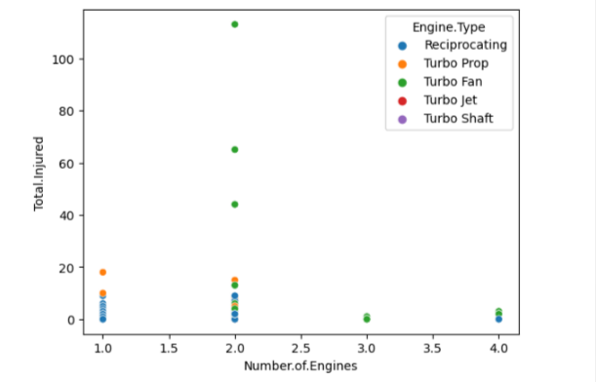
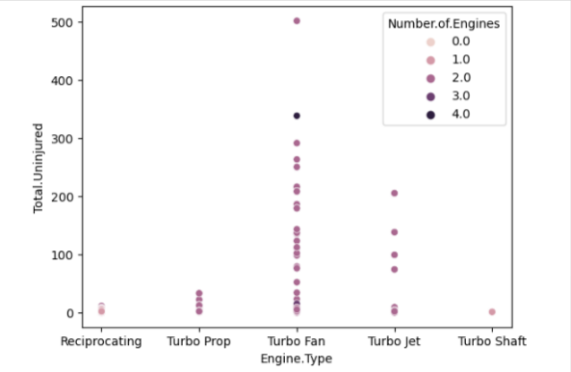
Severity of Hazard
Casualties by Engine Type
Casualties by Number of Engines
Safety by Engine Type

Slide 8
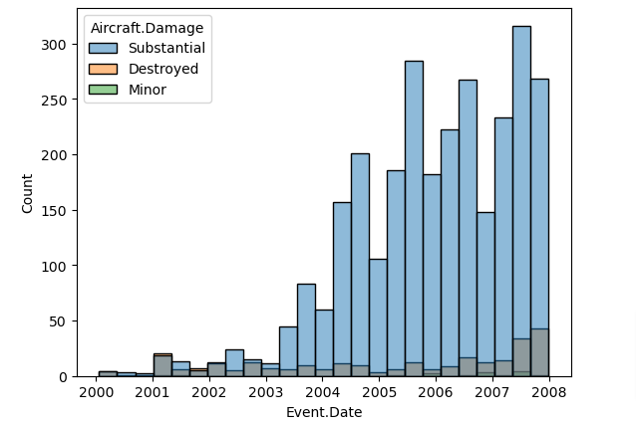
Probability of occurrence
Clearly, the number of accidents has increased over the years.
The rate varies by model and make.
In regards to, Industry generally aircraft damage has remained almost constant.

Slide 9
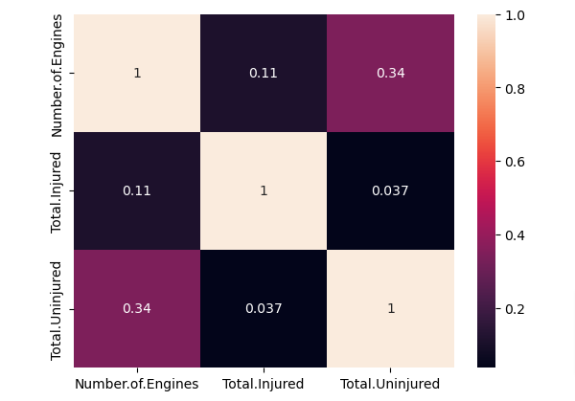
Tolerability of Risk
A composite assessment of risk to assist in comparing risks is derived in two ways:
Multiplying the severity and probability values
Computing the correlation between the different metrics

Slide 10

Conclusion
with Recommendations

Slide 11
“
Data is a tool for enhancing intuition
— Hilary Mason, Data-scientist

Slide 12

Recommendations
Make
Type of Engine
Number of Engines
Amateur Biult
Boeing
Airbus
Reciprocating
Turbo prop
1
2
NO

Slide 13

Contacts
Nairobi, Kenya
+254 700 520 102
gichuhilevis@gmail.com
Levis.gichuhi@student.moringaschool.com
Linkedin: Levis Gichuhi
Github: Levis-KG-Kim

Slide 14

When man defied Gravity

Slide 15
Thank
You!

